Slide 1
Bundle Recommendation via hyper convolutional network

Slide 2
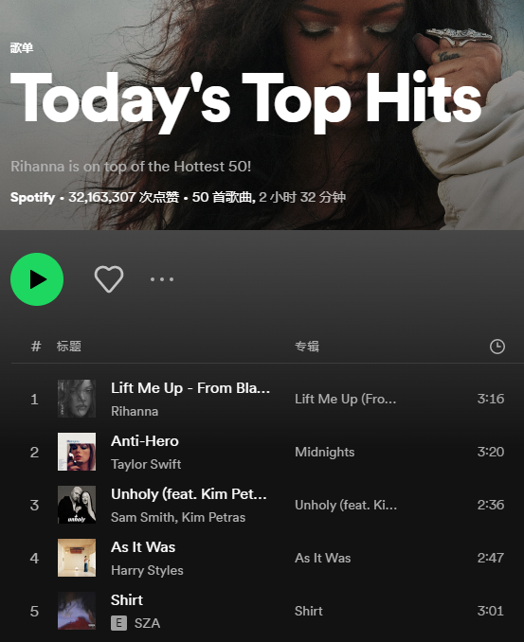
Background
Recommender system
Information overload alleviation
Bundle recommendation :
Recommend a set of items to users
Boost the users’ experience in a one-stop manner
Increase sales revenue
Attract customers fond of bundle discounts
Notes:
Alleviate /ə'livɪ’et/
Recommend /'rɛkə'mɛnd/
E-commerce website
Manner /'mænɚ/
screenshot
1 information age, we receive
2 alleviate
3 bundle
4example 1 example
5 2

Slide 3
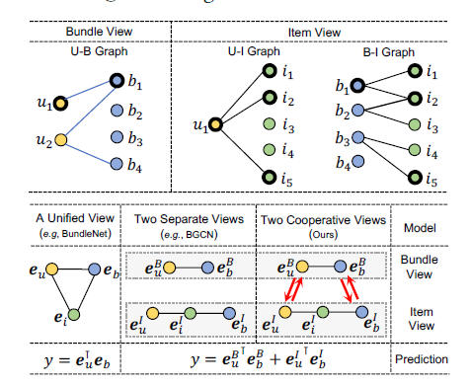
Background
Challenge
Multiple associations
Data sparsity and skew
Previous works
Merge the two views into a unified graph via hypergraph
Model the cooperative association between two views via contrastive learning
Weakness of previous work
Cannot capture the high order dependencies among users and bundles
Notes:
Interact
Via /'vaɪə/

Slide 4
Methodology
Framework
user
item
bundle
Two parts: (1) local view : the hypergraph constructed based on interactions (2) global view: each hyperedge links all the users or bundles .
Notes:
Framework method two part
Learn GraphNN
Bayesian Personalized Ranking CL whole model

Slide 5
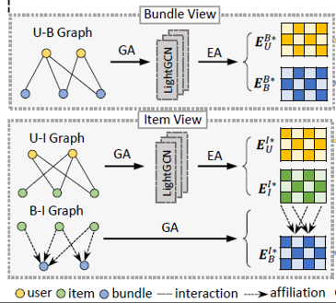
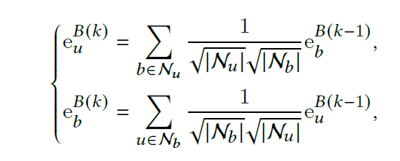
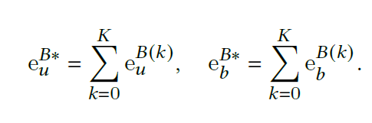
Methodology
Bundle-view representations learning
Propagation
Aggregation
Notes:
This method use lightGCN to learn the node representations of bundle view.
LightGCN simple non-linear transformation function weight matrix
Example

Slide 6
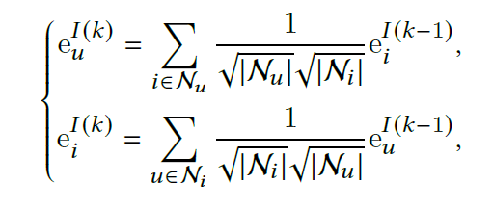
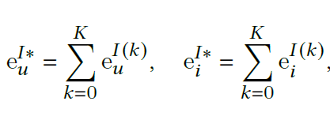
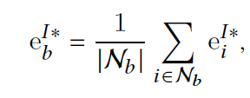
Methodology
Item-view representations learning
Propagation
Aggregation

Slide 7
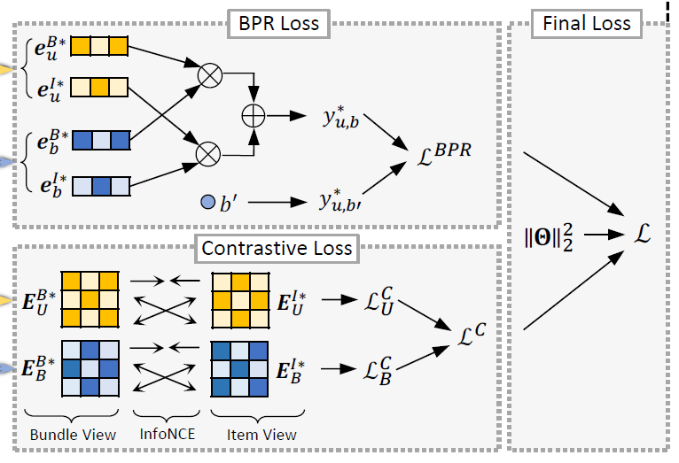
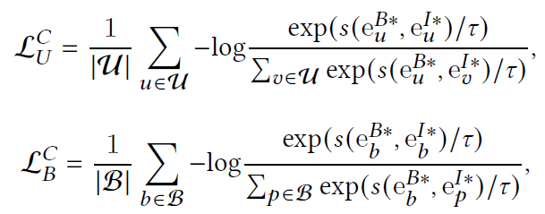




Methodology
Cross-view Contrastive Learning
Contrastive loss
Prediction of Optimization
Prediction loss
Final loss
Notes:
regular term
Numerator /'numəretɚ/
Denominator /dɪ'nɑmə'netɚ/
Integrate

Slide 8
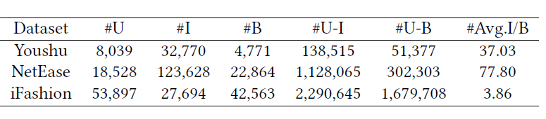
Experiments
Dataset
Metric
Recall@20, Recall@40
NDCG@20,NDCG@40
Notes:
Sparse
Platform /'plæt'fɔrm/

Slide 9
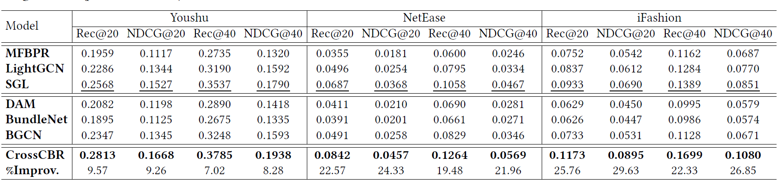
Experiments
Performance Comparison
CrossCBR outperforms all the baselines on the three datasets
SGL demonstrates the great power of contrastive learning
BGCN shows the value of decomposing the users’ preference into two views
User-item
Recommendation
Bundle-specific
Recommendation
Notes:
Decompose /ˌdikəm'poz/

Slide 10
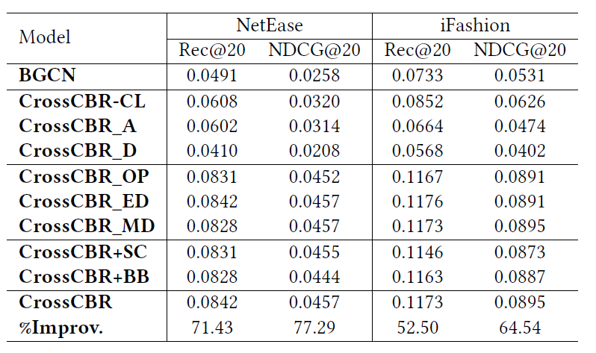
Experiments
Ablation Study
CrossCBR-CL: remove contrastive loss, performance declined
CrossCBR_ED: edge drop of graph-based augmentation, contribute little
CrossCBR+BB ： add bundle-bundle connections in U-B graph, contribute little
Notes:
Ablation /ə'bleʃən/

Slide 11
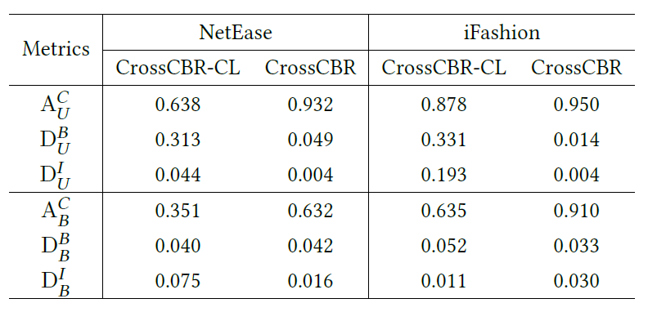
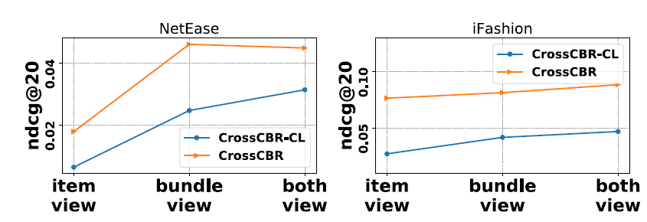
Experiments
Model Study
CL can achieve cross-view mutual enhancement.
CL aligns the same user and bundle representations (A^{𝐶}_{𝑈} and A^{𝐶}_{𝐵})
CL disperses the different user and bundle representations (D^{𝐵}_{𝑈} and D^{𝐼}_{𝑈})
The similarity of the same user’s embeddings on different views
The similarity of the different users’ embeddings on the bundle view
Notes:
The similarity between two different use embeddings of bundle view

Slide 12
Conclusion
It is the first paper which formulates the cross-view cooperative association in bundle recommendation
This paper proposes a simple yet effective bundle recommender, Cross-CBR, to model the cooperative association between two views via contrastive learning.
The proposed model significantly enhanced the SOTA performance of bundle recommendation on three public datasets.

